Slide 1
C++ Course
Games Academy Berlin 2015-05-21 - Day 3
Benjamin Nitschke - Delta Engine

Slide 2
Recap of Day 1
C++ Overview: Pros & Cons, IDEs, Setup, Structure
Test Driven Development
C++ Features
Objects
Data Hiding
Encapsulation
Inheritance
Polymorphism
Pointers
TextAdventure console game
Notes:
Quick recap of Day 1, ask if there are any questions from what was discussed yesterday

Slide 3
Recap of Day 2
OpenGL
via GLFW
Window handling
Immediate drawing
Loading and drawing textures
Sprites
Visual Tests
Creating classes and functionality step by step
SpaceInvaders game
Notes:
Ask if there are any questions from what was discussed so far

Slide 4
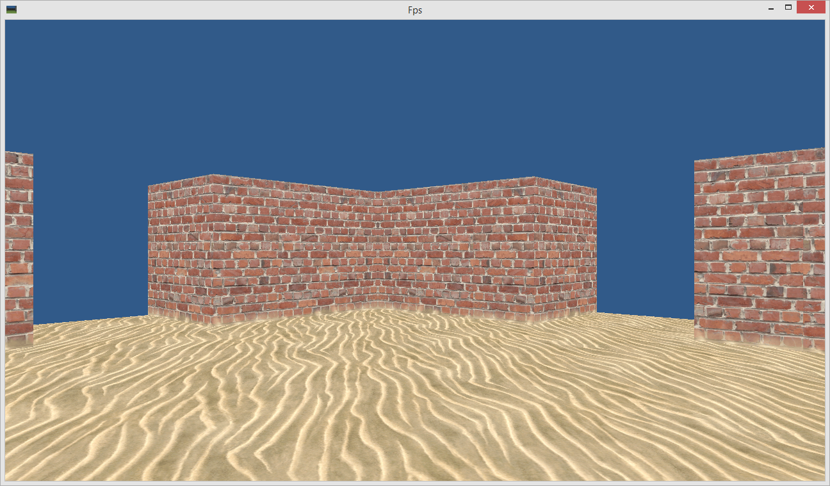
Goal for today: First Person Shooter
Notes:
We will focus on Learning 3D, Vertices, Geometry and Rendering & Matrices.
The game can be extended like yesterday, but 3D is a big topic and will eat up a lot of time. We will also create a FPS game tomorrow, but via Unreal Engine, which does a lot for us already.

Slide 5
Create Fps C++ project
Like before create a new Win32 C++ project
Clean up files (empty Fps.cpp)
Only leave Fps.h, Fps.cpp, stdafx.h and targetver.h
Add GLFW and libpng16 libraries
like we did yesterday for SpaceInvaders
Also name icon resource GLFW_ICON
Copy Game.h and Game.cpp
but remove any SpaceInvaders functionality
test if it all works (we should see an empty window)

Slide 6
Reusing classes -> create library
Notice how we need these classes again:
Game
Texture
Sprite
(and more if you added useful stuff)
Instead of copying them over we should have a common library that we can reuse
Let’s create CppGameEngine as a static library project and change SpaceInvaders and Fps to use it

Slide 7
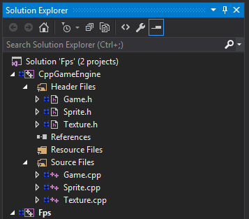
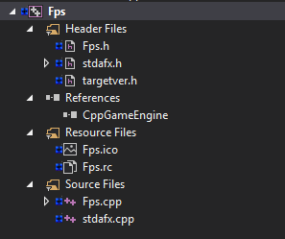
CppGameEngine
This takes care of the compiling order, but you still must add CppGameEngine.lib and include paths “..\CppGameEngine” plus glfw and libpng
Notes:
Let’s keep the new Win32 static library project really simple, no precompiled header, no sdl checks, just create an empty project and move Game, Texture and Sprite classes into it. Setup the include paths (libraries do not have to be setup, never use them in a static library project).
Then add a reference to it in our Fps game (we also will have to do the same for the SpaceInvaders project from yesterday soon)

Slide 8
Rename namespace and clean up
namespace CppGameEngine
{
class Texture
{
public:
Texture(std::string filename);
class ImageNotFound : public std::exception {};
~Texture();
int GetHandle()
{
return handle;
}
private:
GLuint handle;
int width;
int height;
};
}
Notes:
Let’s keep the new Win32 static library project really simple, no precompiled header, no sdl checks, just create an empty project and move Game, Texture and Sprite classes into it. Setup the include paths (libraries do not have to be setup, never use them in a static library project).
Then add a reference to it in our Fps game (we also will have to do the same for the SpaceInvaders project from yesterday soon)

Slide 9
Simplify Game class
class Game
{
public:
Game(std::string gameName);
~Game();
void Run(std::function<void()> tickMethod);
virtual void PlayGame() = 0;
static bool leftPressed;
static bool rightPressed;
static bool upPressed;
static bool downPressed;
static bool spacePressed;
float GetTimeDelta() { return static_cast<float>(timeThisTick); }
private:
GLFWwindow* window;
double lastTime;
double timeThisTick;
protected:
double time;
};
Notes:
The constructor now accepts a game name, which can be specified by a derived class.
Notice the virtual void PlayGame() = 0; method definition, this is an abstract method in C++ that must be implemented in a derived class.
We have also added up and down to the input handling (which is still very crappy and should go into its own class in a future refactoring).
And finally time is available to derived classes, the other fields stay private.

Slide 10
Game class implementation
bool Game::leftPressed;
bool Game::rightPressed;
bool Game::upPressed;
bool Game::downPressed;
bool Game::spacePressed;
void OnKeyPressed(GLFWwindow* window, int key, int scancode, int action, int mods)
{
if (key == GLFW_KEY_LEFT || key == GLFW_KEY_A)
Game::leftPressed = action != GLFW_RELEASE;
else if (key == GLFW_KEY_RIGHT || key == GLFW_KEY_D)
Game::rightPressed = action != GLFW_RELEASE;
else if (key == GLFW_KEY_UP || key == GLFW_KEY_W)
Game::upPressed = action != GLFW_RELEASE;
else if (key == GLFW_KEY_DOWN || key == GLFW_KEY_S)
Game::downPressed = action != GLFW_RELEASE;
else if (key == GLFW_KEY_SPACE || key == GLFW_KEY_LEFT_CONTROL || key == GLFW_KEY_RIGHT_CONTROL)
Game::spacePressed = action != GLFW_RELEASE;
else if (key == GLFW_KEY_ESCAPE)
glfwSetWindowShouldClose(window, true);
}

Slide 11
Implement FpsGame
Does nothing except confirm our CppGameEngine works
#include "Game.h"
namespace Fps
{
class FpsGame : public CppGameEngine::Game
{
public:
FpsGame()
: Game("Fps") {}
void PlayGame() override { Run([]() {}); }
};
}
Notes:
PlayGame obviously has to be changed later to execute the whole game, but we will focus on visual tests next.
Also notice the override for the PlayGame method, it is not required, but helps us to see immediately that this is a virtual method we are overriding.

Slide 12
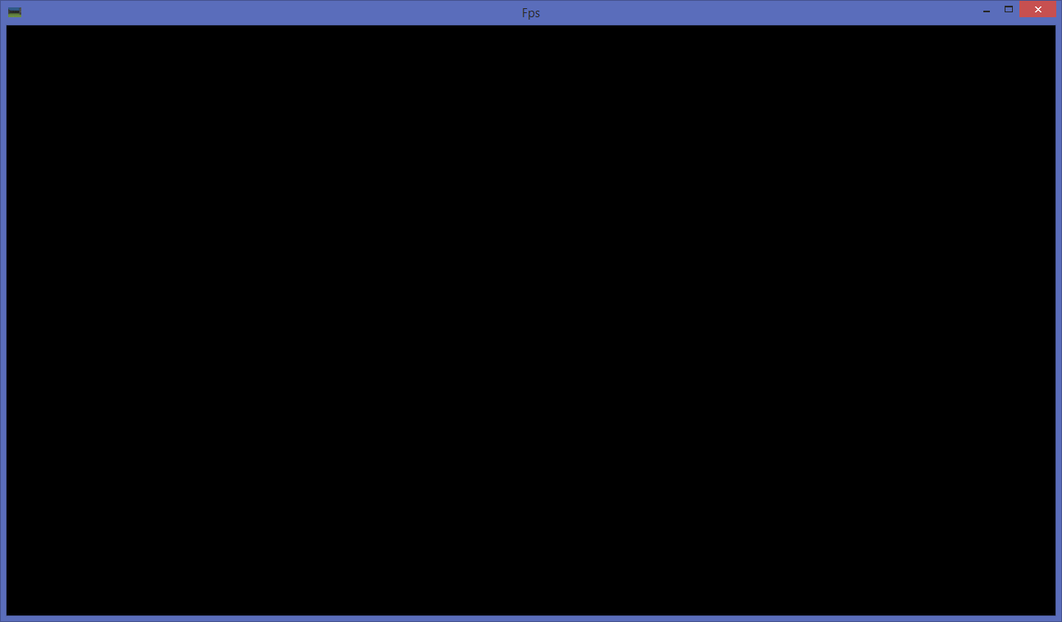
Victory at last
Notes:
If we have done everything correctly, we finally see our empty window again, this time with the FPS icon and the super creative title for this game: “Fps”

Slide 13
Fix SpaceInvaders project
We now have CppGameEngine that can be utilized in the SpaceInvaders solution
Add existing CppGameEngine project to it
Fixup include and library paths
Derive SpaceGame from Game
Fix all compiler errors
Test

Slide 14
Back to Fps.sln
Any change will benefit both projects now
unless we make a breaking change, so be careful
Next up
Loading textures for ground and walls
Building the ground and showing a sky background
Creating walls (by importing a text file)
Displaying 3D Walls
Rotate around with a camera
Moving around the new 3D world

Slide 15
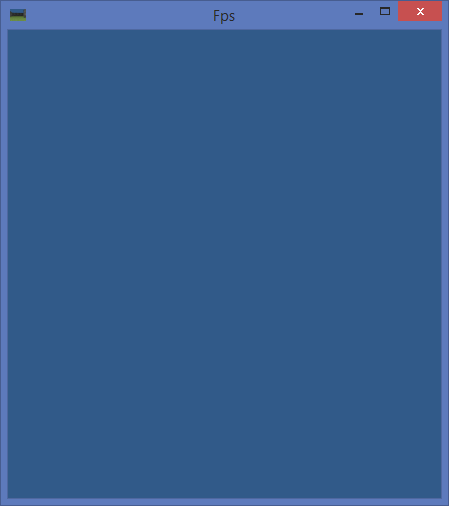
Create FpsVisualTests
class FpsVisualTests : public FpsGame
{
public:
void ShowSkyBackground()
{
glClearColor(
49 / 255.0f, 90 / 255.0f,
137 / 255.0f, 1.0f);
Run([]() {});
}
};
Since all tests and the game assume we always have this sky color set, let’s move it into the FpsGame constructor!
Notes:
This game will also be driven completely by visual tests, we won’t implement any game logic or any testable code.
We don’t have to repeat the tests from SpaceInvaders, we can always go back to them if we want to test something like ShowEmptyWindow.

Slide 16
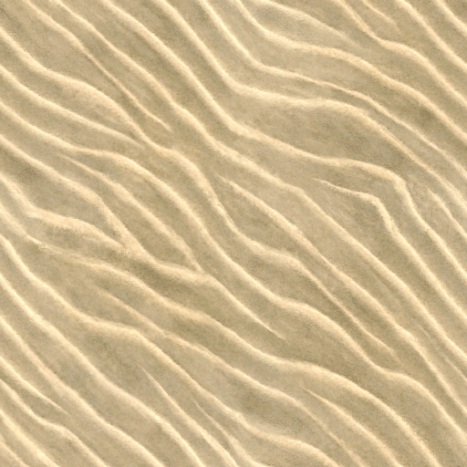


Textures
Ground.png Wall.png
The sky will just use the blue color: 49, 90, 137
Notes:
Again, you are free to use whatever textures you like. Check out this site for cool textures: http://texturelib.com/ (and there are many more on the internet)

Slide 17
LoadGroundAndWallTextures
void LoadGroundAndWallTextures()
{
auto groundTexture = std::make_shared<Texture>("Ground.png");
auto wallTexture = std::make_shared<Texture>("Wall.png");
auto ground = std::make_shared<Sprite>(groundTexture, -0.5f, 0.0f, 0.5f, 0.5f);
auto wall = std::make_shared<Sprite>(wallTexture, 0.5f, 0.0f, 0.5f, 0.5f);
Run([=]()
{
ground->Draw();
wall->Draw();
});
}
Again, let’s move groundTexture and wallTexture into FpsGame as we always need them.
Notes:
However we do not need the sprites

Slide 18
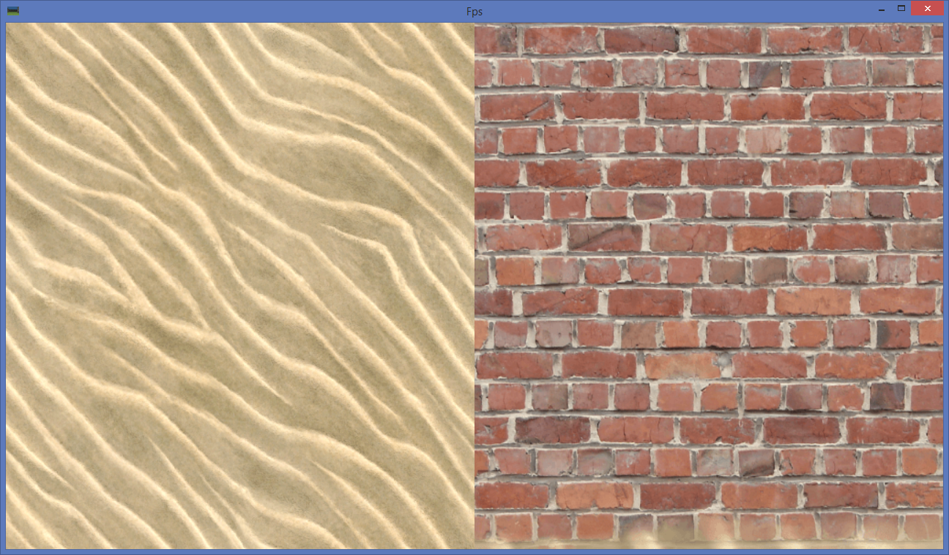
LoadGroundAndWallTextures
Notes:
However we do not need the sprites

Slide 19
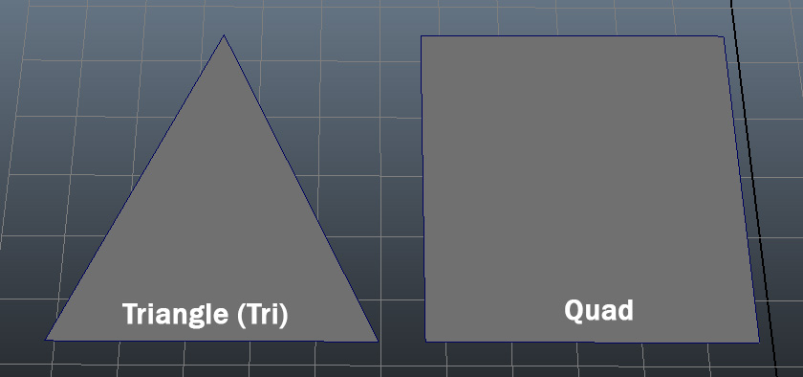
3D Primer: Triangles and Quads
With most 3D Technologies and pretty much all 3D games Triangles are the lowest unit
Notes:
A quad is just 2 triangles, it is used a lot for 2D drawing and most flat surfaces are build out of quads usually. We will use quads as well, but not specify them explicitly, just 2 triangles are one quad.

Slide 20
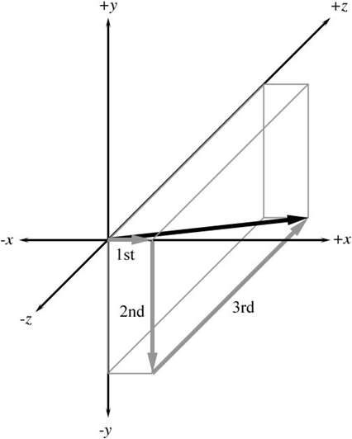
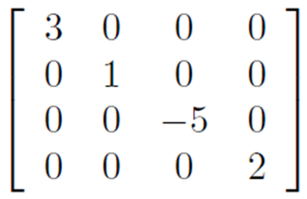
3D Primer: Vectors and Matrices
Again, not our focus today, spend more time on this if you don’t have strong math and 3D skills yet.
Vector Matrix
(x, y, z) (4x4)
Notes:
http://www.3dgep.com/3d-math-primer-for-game-programmers-matrices/
http://www.gamemath.com/

Slide 21
3D Primer: Vertex Format
We already used this in SpaceInvaders
VertexPositionUV
Position data: x, y, z
Texture Coordinate: u, v
5 floats, each 4 bytes = 20 bytes in total

Slide 22
Create VertexPositionUV struct
struct VertexPositionUV
{
float x, y, z;
float u, v;
static const size_t SizeInBytes = 20;
VertexPositionUV() { x = y = z = u = v = 0; }
VertexPositionUV(const float& x, const float& y, const float& z, const float& u, const float& v)
: x(x), y(y), z(z), u(u), v(v) {}
void Draw()
{
glTexCoord2f(u, v);
glVertex3f(x, y, z);
}
};
Notes:
Basically this just holds the 5 floats. We have also added a Draw method, which renders out this vertex if we previously enabled immediate mode triangle drawing with OpenGL.

Slide 23
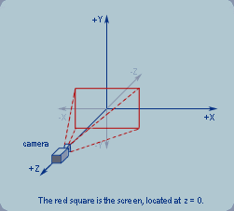
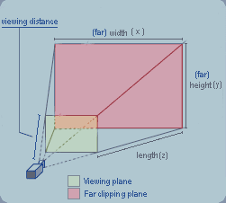
3D Primer: Camera
The camera view matrix allows to position the player in the 3D world while the projection matrix brings the 3D world (after the view matrix was applied) to 2D!
Camera View Matrix: Projection Matrix (near, far plane)
Notes:
http://www.falloutsoftware.com/tutorials/gl/gl0.htm

Slide 24
Camera Matrix Calculations
http://www.falloutsoftware.com/tutorials/gl/gl0.htm
Calculations for Camera Matrix
fov = 60 degrees
znear = 1m
zfar = 100m
zp = 100m + 1m = 101m
zm = 100m - 1m = 99m

Slide 25
Camera Matrix Calculations
1 / tan(60 degrees/ 2)
= 1 / tan(30) =
= 1 / 0.57735
= 1.732
-zp/zm= -101m/99m= -1.0202
-(2*zfar*znear)/zm= -(2*100m*1m)/99m
= -(2*100*1)/99= -200/99 = -2.0202

Slide 26
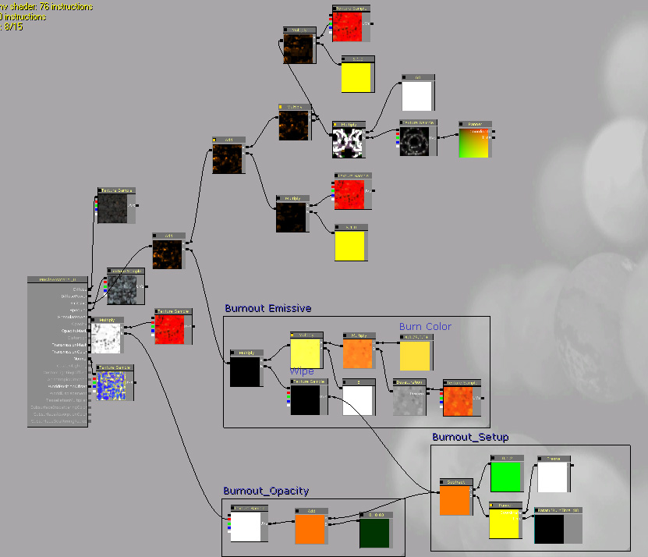
3D Primer: Shaders
Shaders are are very complex topic, we will skip them today
Notes:
http://gamedevelopment.tutsplus.com/articles/3d-primer-for-game-developers-an-overview-of-3d-modeling-in-games--gamedev-5704

Slide 27
3D Primer: Texturing & Lighting
Also not discussed here
We use linear filtering like in SpaceInvaders
No lighting, no normals, no materials
A really nice big article about texturing and lighting can be found here (C++ DirectX11): http://www.3dgep.com/texturing-lighting-directx-11/#more-5761

Slide 28
Building a 3D World
This is going to take time, we have no editor right now.
Even if we would use one, loading files is even more work
Let’s use the simplest file and code we can find
Download NeHe Lesson 10: http://nehe.gamedev.net/data/lessons/vs_net/lesson10.zip
Grab the World.txt, delete the Ceiling part and put it into our Fps folder (and Debug folder)
Copy the SetupWorld code (including readstr) and put it into FpsGame.cpp

Slide 29
Simplify SetupWorld code a bit
void FpsGame::SetupWorld()
{
float x, y, z, u, v;
int numtriangles;
FILE *filein;
char oneline[255];
filein = fopen("world.txt", "rt");
readstr(filein, oneline);
sscanf(oneline, "NUMPOLLIES %d\n", &numtriangles);
for (int loop = 0; loop < numtriangles; loop++)
for (int vert = 0; vert < 3; vert++)
{
readstr(filein, oneline);
sscanf(oneline, "%f %f %f %f %f", &x, &y, &z, &u, &v);
vertices.push_back(VertexPositionUV(x, y, z, u, v));
}
fclose(filein);
}
Notes:
readstr(f, string) can stay unchanged, but you can delete the useless return statement.

Slide 30
Let’s test SetupWorld with debugger
Since we cannot visualize anything yet, use the debugger (F5) to see if all data is loaded correctly.
class FpsVisualTests
{
…
void LoadWorld()
{
SetupWorld();
Run([=]()
{
DrawWorld();
});
}
Put a breakpoint in this line and press F5 to debug (after you call this from main).
F11 to step into SetupWorld
F10 to step over each line there
Hold over numtriangles to see if it is 36
And then checkout the first vertex, which should be x=-3, y=0, z=-3, u=0, v=6.
Finally press F5 to confirm the program runs without any crashes to the end.
Notes:
FpsGame::DrawWorld is an empty method for now

Slide 31
Enable DepthBuffer in FpsGame
Game only sets the blend mode for SpaceInvaders, but nothing for 3D
FpsGame()
: Game("Fps")
{
glClearColor(49 / 255.0f, 90 / 255.0f, 137 / 255.0f, 1.0f);
groundTexture = std::make_shared<Texture>("Ground.png");
wallTexture = std::make_shared<Texture>("Wall.png");
glEnable(GL_TEXTURE_2D);
glClearDepth(1.0);
glDepthFunc(GL_LESS);
glEnable(GL_DEPTH_TEST);
glHint(GL_PERSPECTIVE_CORRECTION_HINT, GL_NICEST);
}
Also clear the depth buffer in Game::Run for each tick:
glClear(GL_COLOR_BUFFER_BIT | GL_DEPTH_BUFFER_BIT);

Slide 32
DrawTriangle on ground
void FpsGame::DrawWorld()
{
glBegin(GL_TRIANGLES);
glTexCoord2f(0, 6);
glVertex3f(-3.0f, 0.0f, -3.0f);
glTexCoord2f(0, 0);
glVertex3f(-3.0f, 0.0f, 3.0f);
glTexCoord2f(6, 0);
glVertex3f(3.0f, 0.0f, 3.f);
glEnd();
}
Not visible? Let’s try different y values

Slide 33
We need a perspective
void FpsGame::SetupProjectionMatrix()
{
glMatrixMode(GL_PROJECTION);
glLoadIdentity();
GLfloat zNear = 0.1f;
GLfloat zFar = 100.0f;
GLfloat aspect = viewportWidth / (float)viewportHeight;
GLfloat fH = tan(float(45.0 / 360.0f * 3.14159f)) * zNear;
GLfloat fW = fH * aspect;
glFrustum(-fW, fW, -fH, fH, zNear, zFar);
}
Notes:
show different projection matrices, end up with the perspective above, in the past gluPerspective could be used, which is a bit simpler than having to setup all the nearplane, farplane, etc. ourselves

Slide 34
DrawGround
void FpsGame::DrawGround()
{
glBindTexture(GL_TEXTURE_2D, groundTexture->GetHandle());
glBegin(GL_TRIANGLES);
for (int v = 0; v < 6; v++) // Ground for first 6 vertices
vertices[v].Draw();
glEnd();
}

Slide 35
DrawWalls
void FpsGame::DrawWalls()
{
glBindTexture(GL_TEXTURE_2D, wallTexture->GetHandle());
glBegin(GL_TRIANGLES);
for (int v = 6; v < (int)vertices.size(); v++) // Rest is walls
vertices[v].Draw();
glEnd();
}

Slide 36
Define Player Position and Heading
Game.h
private:
std::shared_ptr<Texture> groundTexture;
std::shared_ptr<Texture> wallTexture;
std::vector<VertexPositionUV> vertices;
float headingInDegree = 0;
Vector2D playerPosition = Vector2D();

Slide 37
Vector2D struct
struct Vector2D
{
float x, y;
Vector2D() { x = y = 0; }
Vector2D(const float& x, const float& y)
: x(x), y(y) {}
Vector2D operator*(const float& scale) const
{
return Vector2D(x*scale, y*scale);
}
Vector2D operator+(const Vector2D& other) const
{
return Vector2D(x+other.x, y+other.y);
}
};
Notes:
Obviously this needs to be extended with more operators the more things we need, this is just the beginning of creating a useful datatype

Slide 38
Handle Input
Again, this is math heavy, lets go through it step by step
M_PI is defined in Math.h, but only with #define _USE_MATH_DEFINES
void FpsGame::HandleInput()
{
const float DegreeToRadians = (float)M_PI / 180.0f;
const float MoveSpeed = 2.0f;
const float RotationSpeed = 90.0f;
if (upPressed || downPressed)
{
auto movement = Vector2D(
(float)sin(headingInDegree*DegreeToRadians) * MoveSpeed * GetTimeDelta(),
(float)cos(headingInDegree*DegreeToRadians) * MoveSpeed * GetTimeDelta());
playerPosition = playerPosition + movement * (upPressed ? -1.0f : 1.0f);
}
if (leftPressed || rightPressed)
headingInDegree += (leftPressed ? 1.0f : -1.0f) * RotationSpeed * GetTimeDelta();
}

Slide 39
Now handle the view camera matrix
void FpsGame::SetupCameraViewMatrix()
{
glMatrixMode(GL_MODELVIEW);
glLoadIdentity();
glRotatef(360.0f - headingInDegree, 0, 1.0f, 0);
glTranslatef(-playerPosition.x, -0.5f, -playerPosition.y);
}

Slide 40
Overview what we have now
class FpsGame : public CppGameEngine::Game
{
public:
FpsGame();
void PlayGame() override;
void SetupWorld();
void HandleInput();
void DrawWorld();
void SetupProjectionMatrix();
void SetupCameraViewMatrix();
void DrawGround();
void DrawWalls();
protected:
std::shared_ptr<Texture> groundTexture;
std::shared_ptr<Texture> wallTexture;
private:
std::vector<VertexPositionUV> vertices;
float headingInDegree = 0;
Vector2D playerPosition = Vector2D();
};

Slide 41
PlayGame and DrawWorld
void FpsGame::PlayGame()
{
SetupWorld();
Run([=]()
{
HandleInput();
DrawWorld();
});
}
void FpsGame::DrawWorld()
{
SetupProjectionMatrix();
SetupCameraViewMatrix();
DrawGround();
DrawWalls();
}
Notes:
The two most important high level methods

Slide 42
There is a lot more that can be done
Ideas
Shooting
Sound
Jumping
More textures, materials, shaders
Particles
UI
Notes:
If there is time, discuss what would be interesting next, probably there is no time, this is by far the hardest thing to do when just learning a new programming language :)

Slide 43
Questions?
All code and these slides are available at:
https://github.com/BenjaminNitschke/CppCourse/Day3

Slide 44
OpenGL C++ Books
OpenGL SuperBible (Wright, Haemel, Sellers)
http://openglbook.com/
Essential 3D Game Programming: with C++ and OpenGL
The OpenGL Programming Guide: The Official Guide to Learning OpenGL Version 3
OpenGL(R) ES 2.0 Programming Guide
Game Programming Gems 1-8
Notes:
You will learn the most and the fastest if you have a topic (like graphics programming) that interests you, OpenGL is very closely tied to how C works, so if you know one well, you are likely also good at the other technology too.

Slide 45
3D Programming C++ Links
http://www.glfw.org/
https://www.opengl.org/
http://nehe.gamedev.net/
http://fabiensanglard.net/quakeSource/index.php
https://github.com/id-Software
http://www.opengl-tutorial.org/
https://www.opengl.org/sdk/docs/tutorials/
https://www.chromeexperiments.com/webgl
Notes:
Also see C++ links from yesterday

